Slide 1
STARBUCKS ANALYSIS
Bhanu Prakash Mahadevuni C0850515
Deeksha Naikap C0835440
Pramod Reddy Gurrala C0850493
Sai Varun Kollipara C0828403

Slide 2
Problem Statement
Starbucks is one of the famous café that is available all around the globe and having a wide range of products.
Customers are the biggest investment for Starbucks, So we are trying to identify the drinks with good nutrition's and bad nutrition’s.
Dataset considered for this problem is Starbucks Nutrition Data from Kaggle.

Slide 3
Starbucks Data Analysis using Big Data
Volume - Starbucks Nutrition Data has 3 files. First file has 7 Colom's and 173 Rows. Second file has 6 Column's and 130 Rows. Third file has 6 Column's and 130 Rows.
Value - Customers are the main strength for many companies. So, the value of the analysis provides insights and profits.
Variety - The data covers all the items present in the menu like foods, drinks and beverages.
Velocity - As the new items are being added into the menu, the information related to it will be keep on accumulating and increased the growth in the dataset, but the rate is slow.
Veracity - The information considered in this dataset is highly accurate, but there are some missing fields for some columns.

Slide 4
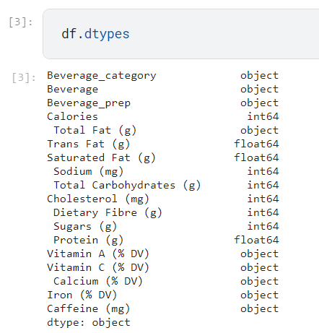
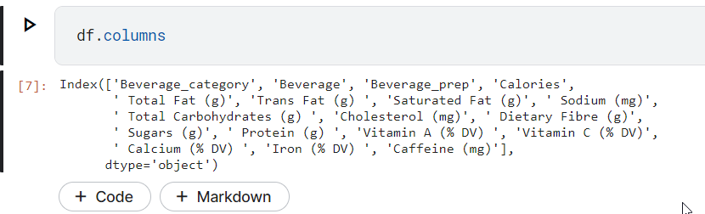
Variety

Slide 5
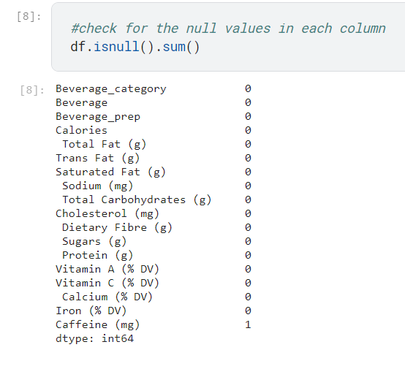
Veracity

Slide 6
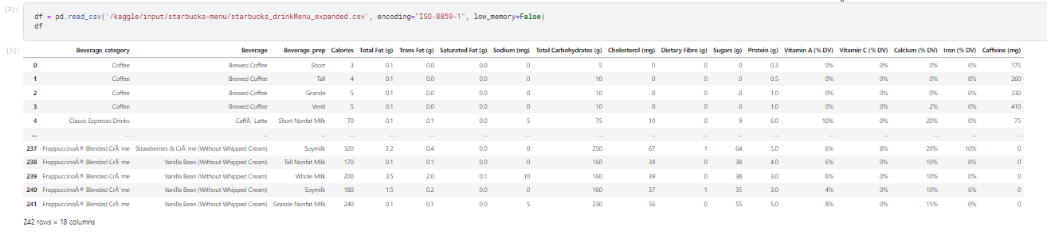
Volume

Slide 7
Velocity
Value
The velocity depends on the new products that are being updated into the menu.
The velocity will be monthly / season-based
The focused area is customer health.
The value varies based on the implementation of the results provided.

Slide 8
Descriptive Analysis

Slide 9
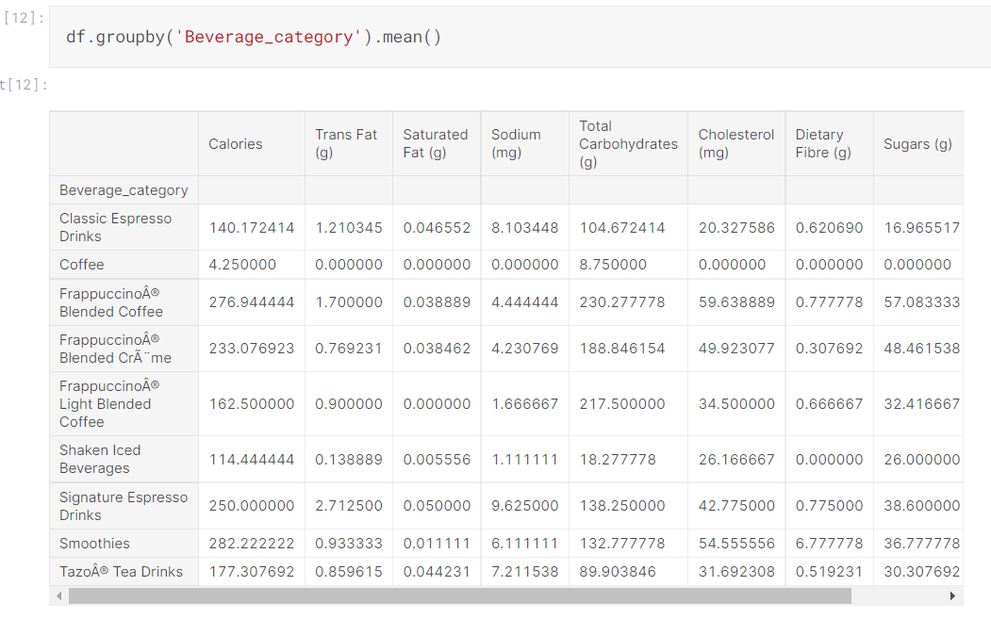
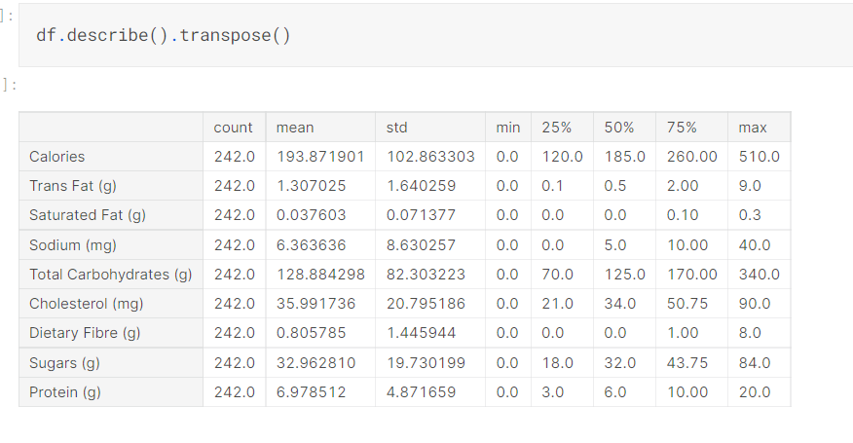

Slide 10
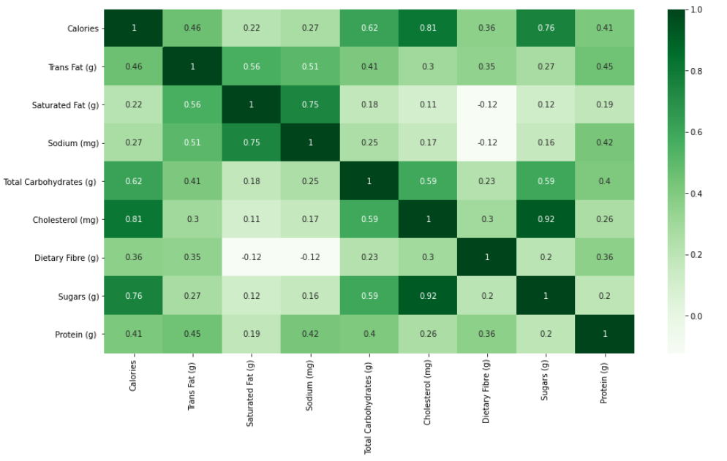

Slide 11
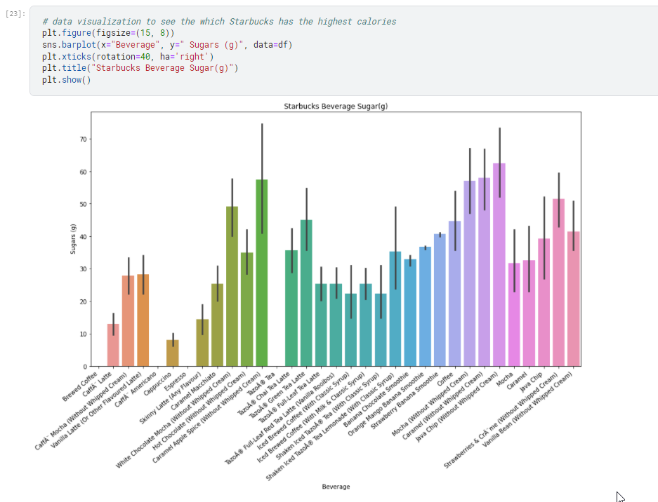
Sugars

Slide 12
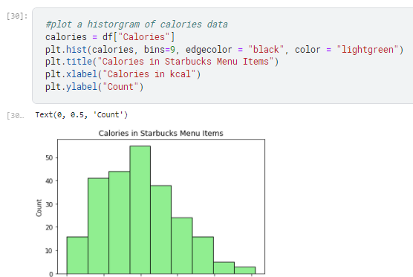
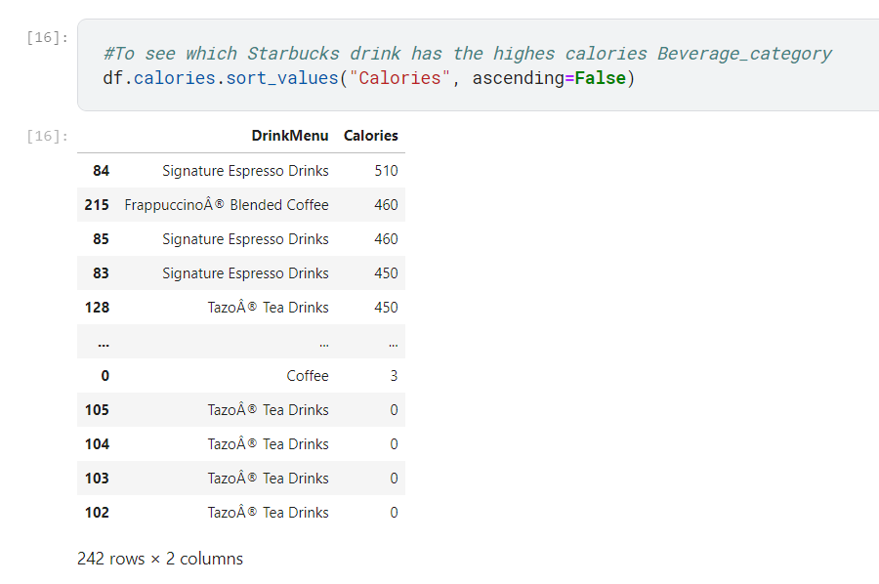
Calories

Slide 13
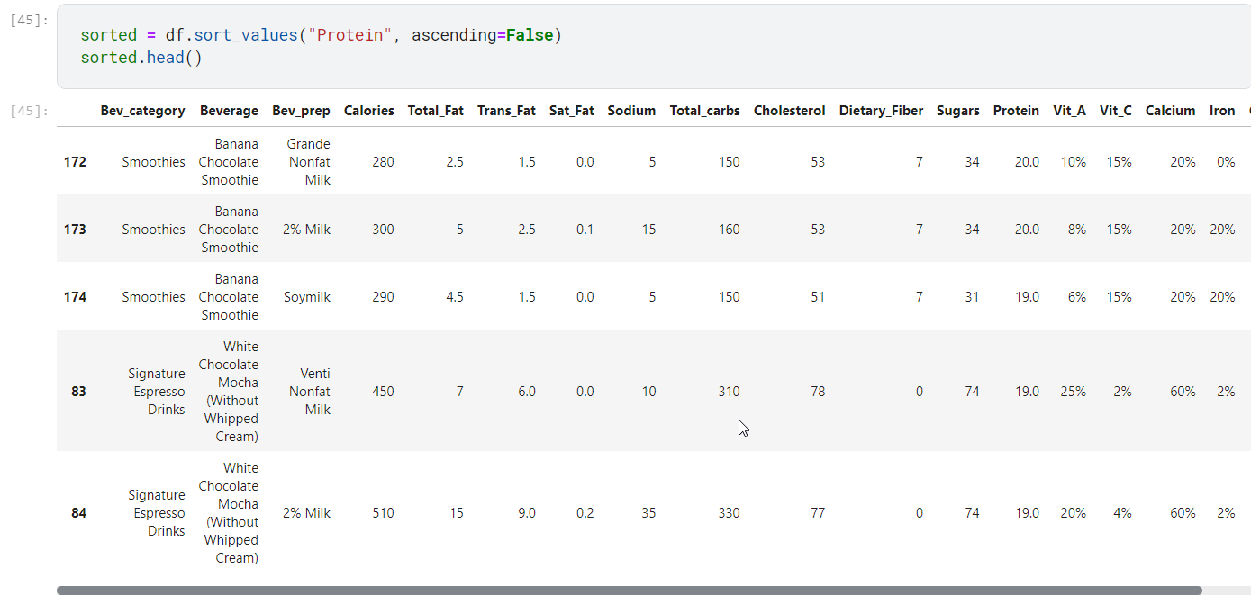
Protein

Slide 14
